Slide 1
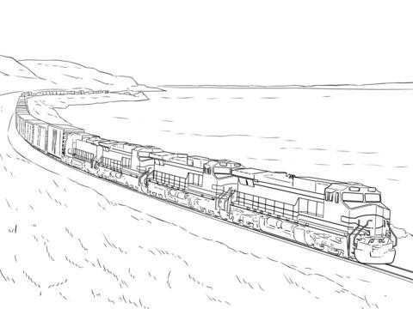

Slide 2
USB
Base Station
Cab Handhelds
Layout Control Bus
Gateway
Boosters
Sensors
Actors
Layout Elements
Ethernet, Wifi, etc.
DCC Track

Slide 3
LCS Node
Non-volatile Storage (NVM)
Volatile Storage (MEM)
Configuration
Descriptor
Node Map
Node Map
create
Port Map
Port Map
Event Map
sync
Event Map
access
Attribute Map
Attribute Map

Slide 4
LCS Node
Module Firmware
Methods
Callbacks
ModuleHardware specific APIs
LCB Library
Module Hardware

Slide 5
LCS Node Library Structure
Lcs Node - Module Firmware
LCB Core Library
. . .
NVM Lib
CanBus Lib
Controller Dependent Code
Module Hardware

Slide 6
LCS Node Software Library Structure
Lcs Node - Module Firmware
LCB Core Library
. . .
CanBus Lib
NVM Lib
PIO Lib
UI Lib
Controller Dependent Code
Module Hardware

Slide 7
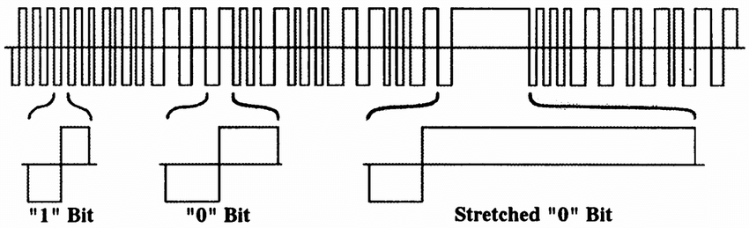

Slide 8
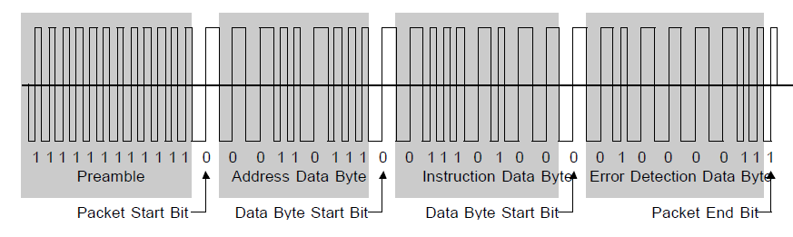

Slide 10
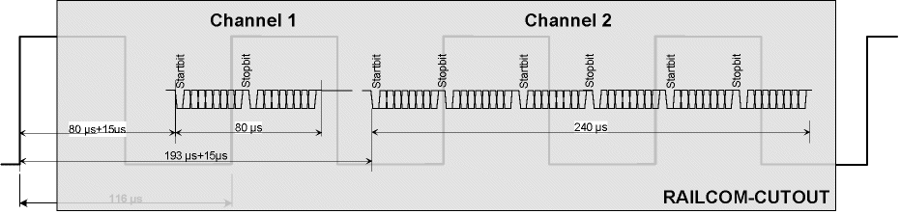

Slide 11
Trac
DCC Track Sections
Track
Booster
Booster
Booster
Booster
Base
Station
LCS Bus

Slide 12
Trac
Analog block control
Block
Track
Sections
PWM Signal
Block
Detect
PWM Signal
PWM Signal
Block
Detect
PWM Signal
Block Controller
Block Controller
Base
Station
DCC Signal
LCS Bus
LCS Command
Cab
Handheld

Slide 13
H-Bridge Signal Convention
VS
In1
Out1
(„+“ )
Out2
(„-“ )
In2
Sense
R-Sense
GND

Slide 14
Block Element
Next
Block
B
Signal
Moving
Direction
Signal
A
Signal
Optional
Turnout
C
Previous
Block
Next
Block

Slide 15
Blocks
Moving Direction
A
Distant
Signal
Main
Signal
Distant
Signal
Main
Signal
Distant
Signal
Main
Signal
B
Approach Indication
Approach Indication
Approach Indication
Moving Direction
A
Main
Signal
Main
Signal
Main
Signal
B
Approach Indication
Approach Indication
Approach Indication

Slide 16
Modular Building Blocks
Main Board
Extension Board
Extension Board
LCS Bus
Connectors
Extension
Connector
Extension
Connector
Extension
Connector
OUT
IN
OUT
IN
External
Power In

Slide 17
Base Station Extension Module
Main Board
Base Station Extension – Dual L6205 and Railcom
Extension
Board
PWR
LCS Bus
Connectors
H-Bridge
( Main )
H-Bridge
( Prog )
OUT
IN
OUT
IN
RailCom Detector
External
Power In
Main Track
Prog Track

Slide 18
Block Controller Concept – Main Board
Main Controller and Power Module Board
Extension Board(s)
-> occupancy detect
-> turnout control
-> signal control
LCS
DCC Signal
Detector
H-Bridge
RailCom
Track A
LCS
Driver Logic
Main Controller
OUT
IN
H-Bridge
Power Supply
RailCom
IN
Track B

Slide 19
A
Block Controller Concept – Extension Board
Controller Board
Extension Board
Track Sections
Turnouts and Signals
A
A
Detectors
Drivers
Occupancy Detector Logic
Turnout control Logic
Signal Control Logic
OUT
IN
OUT
B
B
Detectors
Drivers
Track Sections
Turnouts and Signals

Slide 20
Cab Handheld
Horn
Menu
Up
Menu
Display
Select
Down
Sel
F1
F2
F3
F4
Dir
Speed
Bell

Slide 21
Diesel Cab Handheld
Horn
Menu
Up
Menu
Display
Select
Down
Sel
Throttle
Dir
Brake
Bell
F1
F2
F3
F4

Slide 22


Layout Guidance Computer
st
st
st
st
Node
0
1
2
3
Select
Verb
4
5
6
7
Clear
Noun
8
9
A
B
+
C
D
E
F
-

Slide 23
